Slide 1

Stack Abstract Data Type

Slide 2

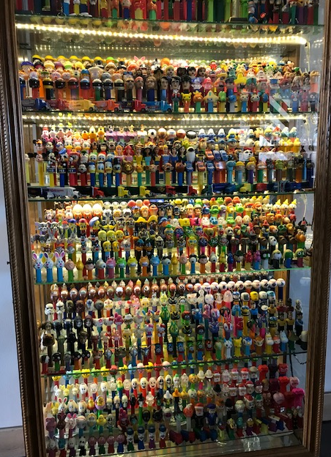
Stack Abstract Data Type
A stack is one of the most commonly used data structures in computer science
Notes:
Production Notes: On screen
Notes to Cheryl: Can you bring in a Pez dispenser? Can I have a Pez? If you don’t have one I can try to find one. I have a pez dispenser.
A stack can be compared to a Pez dispenser
Only the top item can be accessed
You can extract only one item at a time
The top element in the stack is the last added to the stack (most recently)
The stack’s storage policy is Last-In, First-Out, or LIFO
Applications of stacks, think of last in first out applications
Page-visited history in a Web browser
Undo sequence in a text editor
Chain of method calls (think of the recursion module and the traces…the first to finish was the last to start)
Just for fun…. This is a Pez dispenser collection displayed at the American Visionary Arts Museum in Baltimore. Perhaps you, too, will now go to art museums and think of data structures.

Slide 3
The Stack ADT
Data:
The objects
A reference to the object on top of the stack
Operations:
push(object): inserts an element
pop(): removes and returns the last inserted element
peek(): returns the last inserted element without removing it
size(): returns the number of elements stored
isEmpty(): indicates whether no elements are stored
Notes:
Production notes: on screen
Here is a definition of the Stack Abstract Data Type
The data includes the items in the stack, and the count of how many items are on the stack.
The operations are push, inserting an item on the stack,
pop, taking an item out of the stack
Peek, the value of the item on top of the stack (without removing it)
Size, how many items are on the stack,
And isEmpty

Slide 4
main() { int i = 5; foo(i); }
foo(int j) { int k; k = j+1; bar(k); }
bar(int m) {
m=6 bear();
}
bar
PC = 9 m = 6
foo
PC = 3 j = 5
k = 6
Method Stack
main
PC = 2 i = 5
Notes:
Production notes off screen
Running programs keeps track of the chain of active methods with a stack
When a method is called, a frame is pushed on the stack containing (indicate foo(i) running and the frame for main being pushed on the stack, then bar)
Local variables and return value
Program counter, keeping track of the statement being executed
When a method ends, its frame is popped from the stack and control is passed to the method on top of the stack
Allows for recursion

Slide 5
Finding Palindromes
Palindrome: a string that reads identically in either direction, letter by letter
“kayak”
"I saw I was I”
“able was I ere I saw elba”
Solve using a stack
Push each string character, from left to right, onto a stack
Pop each character off the stack, appending each to a new string
Compare the two strings
Notes:
Problem: Write a program that reads a string and determines whether it is a palindrome
Show an example of each step

Slide 6
Finding Palindromes
String = “canal”
______ New String =
Stack
Notes:
We are going to use a stack to determine if the string is a palindrome
We go character by character through the line and push the characters on the stack.
(push c, push a, push n, push a, push l).
Now we pop the characters and put them in the new string.
Pop l, pop a, pop n, pop a, pop c
Is the new string the same as the orignal? No? Then it’s not a palindrom.

Slide 7
Balanced Parentheses
( a + b * ( c / ( d – e ) ) ) + ( d / e )
Algorithm for method isBalanced
Create an empty stack of characters
Assume that the expression is balanced (balanced is true).
Set index to 0
while balanced is true and index < the expression’s length
Get the next character in the data string
if the next character is an opening parenthesis
Push it onto the stack.
else if the next character is a closing parenthsis
Pop the top of the stack
if stack was empty or its top does not match the closing parenthesis
Set balanced to false
Increment index
Return true if balanced is true and the stack is empty
_________
Stack
Notes:
When analyzing arithmetic expressions, it is important to determine whether an expression is balanced with respect to parentheses
The problem is further complicated if braces or brackets are used in conjunction with parentheses
The solution is to use stacks!
We will go through the string at the top one character at a time and push open parens and pop close parens.

Slide 8
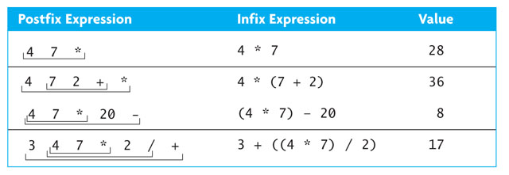
Stacks and Postfix
Notes:
Expressions are normally written in infix form, but compilers convert them to postfix
Postfix is easier to evaluate because it doesn’t require parentheses or determination of operator precedence
Stacks are then used to evaluate the postfix
Stacks can be used for the conversion

Slide 9
Evaluating Postfix Expressions (cont.)
4
4
7
*
20
-
1. create an empty stack of integers
2. while there are more tokens
3. get the next token
4. if the first character of the token is a digit
5. push the token on the stack
6. else if the token is an operator
7. pop the right operand off the stack
8. pop the left operand off the stack
9. evaluate the operation
10. push the result onto the stack
11. pop the stack and return the result
4
Notes:
Production notes: off screen

Slide 10
Evaluating Postfix Expressions (cont.)
4
4
7
*
20
-
7
1. create an empty stack of integers
2. while there are more tokens
3. get the next token
4. if the first character of the token is a digit
5. push the token on the stack
6. else if the token is an operator
7. pop the right operand off the stack
8. pop the left operand off the stack
9. evaluate the operation
10. push the result onto the stack
11. pop the stack and return the result
4
Notes:
Production notes: off screen

Slide 11
Evaluating Postfix Expressions (cont.)
4
4
7
*
20
-
1. create an empty stack of integers
2. while there are more tokens
3. get the next token
4. if the first character of the token is a digit
5. push the token on the stack
6. else if the token is an operator
7. pop the right operand off the stack
8. pop the left operand off the stack
9. evaluate the operation
10. push the result onto the stack
11. pop the stack and return the result
7
4
Notes:
Production notes: off screen

Slide 12
Evaluating Postfix Expressions (cont.)
4
4
7
*
20
-
28
1. create an empty stack of integers
2. while there are more tokens
3. get the next token
4. if the first character of the token is a digit
5. push the token on the stack
6. else if the token is an operator
7. pop the right operand off the stack
8. pop the left operand off the stack
9. evaluate the operation
10. push the result onto the stack
11. pop the stack and return the result
Notes:
Production notes: off screen

Slide 13
Evaluating Postfix Expressions (cont.)
4
4
7
*
20
-
1. create an empty stack of integers
2. while there are more tokens
3. get the next token
4. if the first character of the token is a digit
5. push the token on the stack
6. else if the token is an operator
7. pop the right operand off the stack
8. pop the left operand off the stack
9. evaluate the operation
10. push the result onto the stack
11. pop the stack and return the result
28
Notes:
Production notes: off screen

Slide 14
Evaluating Postfix Expressions (cont.)
4
4
7
*
20
-
1. create an empty stack of integers
2. while there are more tokens
3. get the next token
4. if the first character of the token is a digit
5. push the token on the stack
6. else if the token is an operator
7. pop the right operand off the stack
8. pop the left operand off the stack
9. evaluate the operation
10. push the result onto the stack
11. pop the stack and return the result
20
28
Notes:
Production notes: off screen

Slide 15
Evaluating Postfix Expressions (cont.)
4
4
7
*
20
-
1. create an empty stack of integers
2. while there are more tokens
3. get the next token
4. if the first character of the token is a digit
5. push the token on the stack
6. else if the token is an operator
7. pop the right operand off the stack
8. pop the left operand off the stack
9. evaluate the operation
10. push the result onto the stack
11. pop the stack and return the result
8
Notes:
Production notes: off screen

Slide 16
Evaluating Postfix Expressions (cont.)
4
4
7
*
20
-
1. create an empty stack of integers
2. while there are more tokens
3. get the next token
4. if the first character of the token is a digit
5. push the token on the stack
6. else if the token is an operator
7. pop the right operand off the stack
8. pop the left operand off the stack
9. evaluate the operation
10. push the result onto the stack
11. pop the stack and return the result
8
Notes:
Production notes: off screen

Slide 17
Postfix Conversion
1. create an empty stack of operators
2. create a String for the expression
3. while there are more tokens
3. get the next token
4. if the token is an operand
5. append to expression
6. else if the token is an operator
7. processOperator
8. pop the stack and append to expression
Notes:
Production notes: off screen

Slide 18
Postfix Conversion - processOperator
1. if the stack is empty
2. push the operator
3. else
3. peek at the operator stack and call it topOp
4. if the precedence of operator is > topOp
5. push operator
6. else
7. while the stack is not empty and operator precedence <= topOp precedence
8. pop the stack and append to expression
9. peek at the operator stack and call it topOp
10. push operator
Notes:
Production notes: off screen

Slide 19
Example Problem

Slide 20
Character
Object[]
value = 'J'
ArrayStack
[0] = null
[1] = null
[2] = null
[3] = null
[4] = null
[5] = null
[6] = null
[7] = null
[8] = null
[9] = null
Character
stackArray =
top = -1
3
0
1
2
value = 'a'
Implementing a Stack Using an Array
Character
value = 'v'
Character
value = 'a'
Notes:
Production notes: off screen
Here is an illustration of an array based stack.
The stack object has a pointer to the array and the value of the index of the top of the stack. That index grows as the stack grows.

Slide 21
Character
Object[]
value = 'J'
ArrayStack
[0] = null
[1] = null
[2] = null
[3] = null
[4] = null
[5] = null
[6] = null
[7] = null
[8] = null
[9] = null
Character
stackArray =
top = -1
3
0
1
2
value = 'a'
Implementing a Stack Using an Array
Character
value = 'v'
Character
value = 'a'
Notes:
When the stack is popped the stack index is decreased.

Slide 22
template <typename T>
class Stack {
private:
int top;
int capacity;
T *storage;
public:
Stack(int capacity) {
storage = new T(capacity);
this->capacity =capacity;
top = -1;
}
void push(T value) {
top++;
storage[top]= value;
}
T peek() {
return storage[top];
}
T pop() {
T theTop=storage[top];
top--;
return theTop;
}
bool isEmpty(){
return (top == -1);
}
~Stack() {
delete[] storage;
}
};
Implementing a Stack Using an Array
Notes:
When the stack is popped the stack index is decreased.

Slide 23
Implementing a Stack as a Linked Data Structure
template <typename T>
class Stack {
Private:
struct Node
{
T data
Node * next;
Node(T item)
{ data = item;
next = null;}
void setNext(Node *next)
{ this.next = next;}
T getData()
{ return data;}
}
Node* top;
public:
Stack()
{ top = null;}
We can also implement a stack using a linked list of nodes
Notes:
Production notes: on screen and then step off to go to this website
https://www.cs.usfca.edu/~galles/visualization/StackLL.html

Slide 24
Implementing a Stack as a Linked Data Structure
void push(T value){
//create a new node
Node * newNode = new Node(value);
//make top its next
newNode.setNext(top);
//reset top
top = newNode;
}
T peek() {
return top->data;
}
T pop() {
//pull data from top
T topData = top;
//reset top to top->next;
Node * oldTop = top;
top = top->next;
//delete old top
delete oldTop;
//return data
return topData;
}
bool isEmpty(){
return (top == nullptr);
}
~Stack() {
//clear all the data from the stack
}
};
We can also implement a stack using a linked list of nodes
Notes:
Production notes: on screen and then step off to go to this website
https://www.cs.usfca.edu/~galles/visualization/StackLL.html

Slide 25
Computational Complexity of Stack Operations
Stack
Push/Pop are O(1)
This is why stacks are great data structures if LIFO operations are appropriate
Notes:
The computational complexity of all the stack operations is O(1) or constant time.
This is why stacks are data structures if the application supports last in irst out

Slide 26
Sample Problem
Write a method to reverse the elements on a stack. Use two other stacks to aid in the removal.
void reverseStack (stack S<int>)
{
stack S1<int>, S2<int>;
while (!S.empty())
S1.push(S.pop());
while (!S1.empty())
S2.push(S1.pop());
while (!S2.empty())
S.push(S2.pop());
}

Slide 27
Sample Problem
Write a method to read a string and determine if it has the same number of A’s as B’s.
bool inLanguage(char* theString)
{ std::stack<char> theStack; int i=0;
while (theString[i]!=NULL)
{ if ((theString[i]!='A')&&(theString[i]!='B’)) return false;
if (theStack.empty())
theStack.push(theString[i]);
else
{ if (theStack.top()==theString[i])
theStack.push(theString[i]);
else
theStack.pop(); }
i++; }
if (theStack.empty())
return true;
else
return false;
}

Slide 28


